Slide 1
Update - Week 6 & 7
Dev Bhatia
Ultrafast Optics Laboratory
Boston University

Slide 2
Paper Analysis
Ganguly, M., Jenkins, M. W., Chiel, H. J., &amp; Jansen, E. D. (2016). Modeling the effects of elevated temperatures on action potential propagation in unmyelinated axons. Clinical and Translational Neurophotonics; Neural Imaging and Sensing; and Optogenetics and Optical Manipulation. doi:10.1117/12.2211048

Slide 3
Introduction
Using IR lasers, it is possible to deliver infrared light to tissue with high spatial and temporal specificity to control excitable tissues
Sought to analyze the potential mechanism of thermal inhibition by using computational models of a well-studied invertebrate model - the squid giant axon
Sought to test Huxley’s hypothesis that activation of voltage-dependent potassium ion channels was primarily responsible for thermal inhibition.

Slide 4
Model Axon Geometry
Length of 100mm
Diameter of 0.5mm
Current Injected for 250ms
Simulation timer for 500ms
If model ion axon diameter > 10 um -> depolarizing current = 2000na
If model ion axon diameter < 10 um -> depolarizing current = 100na

Slide 5

Model Axon Geometry
In order to assess the effect of axonal diameter on temperature response, axon diameter was varied from .5 to 500 um
Because axial radii vary with temperature in the HH model, the model was fitted with varying axial resistances
Segmental Current over j different segments

Slide 6
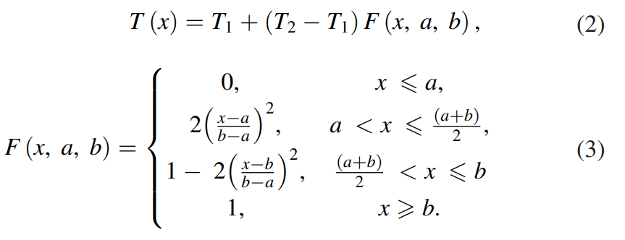
Simulating Temperature Changes
One half of the axon would remain at a base temperature (6.3 °C) while the other half’s temperature would be varied
Done to ensure that the transient currents induced by the initiation of an action potential were minimized
T(x) = Temperature profile
T1 = Initial temperature at location a
T2 = Initial temperature at location b

Slide 7
Simulation Temperature Change – Alt. Method
Temperature change is applied along the central region of a three-section axon
Used to determine the minimum length of the elevated temperature region that could block action potentials
An action potential is considered “blocked” if the potential at the end of the axon never exceeds -60mV

Slide 8
Temperature – Dependent Parameters
Several features of the original HH model would become temperature dependent
Temperature varying Q10 factor
Peak potassium and sodium conductance's
Temperature dependent sodium-potassium pump
Axial resistance as a function of temperature

Slide 9

Q10 Temperature Dependency
In the standard Hodgkin and Huxley model temperature dependence is captured by altering the rate constants for the three gates controlling the voltage gated ion channels
This model multiplies the differential equations for the m, n, and h gates by the Q10 term of the Q10 Relationship

Slide 10
Sodium-Potassium Pump
In the original Hodgkin and Huxley model, the sodium/potassium pump was not incorporated, because their initial studies suggested that the resting membrane potential was unchanged by temperature
This model relies on more contemporary findings, stating that a temperature-dependent sodium–potassium pump significantly contributed to changes in the resting potential with temperature
Equations for this sodium-potassium pump, estimating for the pump Q10, were utilized from van Egeraat and Wikswo

Slide 11
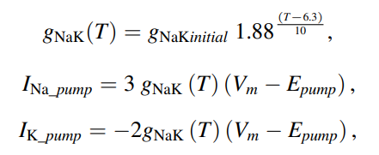
Sodium-Potassium Pump Equations
INa_pump and IK_pump are the sodium and potassium currents due to the pump
Vm = membrane potential
Epump = reversal potential of the pump

Slide 12
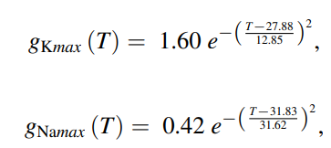
Peak Sodium and Potassium Conductances
In the original Hodgkin and Huxley model, the peak sodium and potassium conductances were assumed to be constant and independent of temperature
Contemporary studies suggest otherwise
By extrapolating data from Rosenthal and Bezanilla (2000) and fitting the curve, the following equations were created:

Slide 13
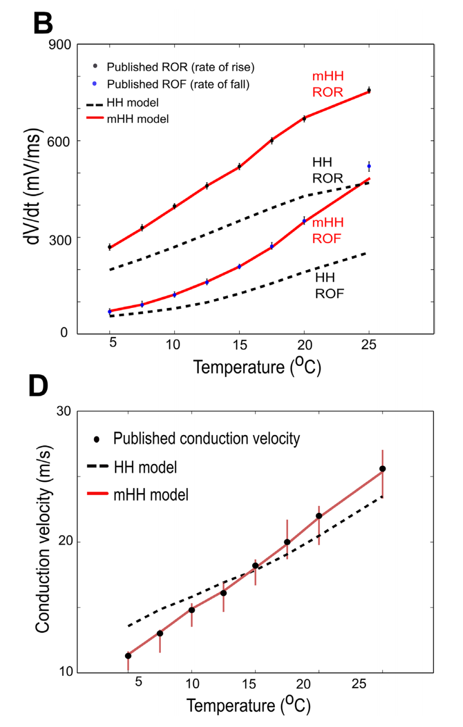
Results – Model Verification
B - Comparisons of model outputs to experimental data measuring rates of rise or fall of squid action potentials
D - Comparisons of measured conduction velocity to model predictions.

Slide 14

Codebase Structure
Each of the numbered items corresponds to the associated numbered figure in the paper
NEURON functions and modalities mentioned in the paper are nowhere in this repository
Indicate that the source NEURON file is not here

Slide 15
Conclusion
With the information presented by this paper, it is clear that this model would be valuable to our group
The modified HH model more accurately describes experimental data
Procuring the source NEURON file would allow us to create models that account for temperature dependence

Slide 16
Former Simulation Updates

Slide 17
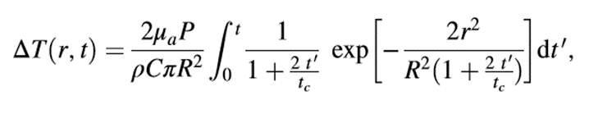


Varying Alternate Parameters
Taken from:
Li, Xinyu, Jia Liu, Shanshan Liang, and Changsen Sun. "980-nm Infrared Laser Modulation of Sodium Channel Kinetics in a Neuron Cell Linearly Mediated by Photothermal Effect." Journal of Biomedical Optics 19, no. 10 (2014): 105002-105002.
μa = 73.9 cm^-1 Optical Absorption Coefficient
R = 93.41 μm Beam waist at axial distance
z = 164.56 μm Axial Distance
tc = .01523 s Characteristic time of the thermal lens
P = variable wattage irradiation laser power, obeys Beer-Lambert law with the initial laser power Po
κ = 0.6 W/mK thermal conductivity
ρ = 1000 kg/m^3 density of water
c = 4188 J kg^-1 K^-1 heat capacity
r = 25 μm radius of the fiber core

Slide 18
Computed Values
Parameter | Dev | Xuedong
Power at the Sample Plane | [0mW – 20mW] | 2.9mW or 5.5mW
Beam Radius at the Sample Plane | 93.41 um | 25.18 um
Beam Radius at the Waist | 25 um | 25 um
Sample Plane Position (z-distance) | 164.56 um | 117.55um
Characteristic Thermal Time Constant | 115 um | 110.54um

Slide 19
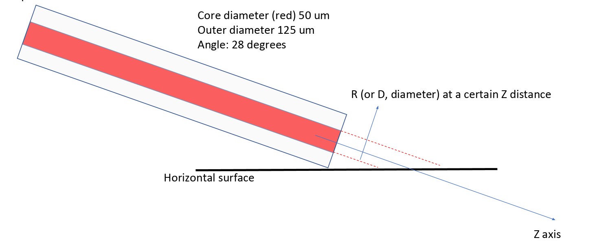


Calculations
R = $\frac{a ∗sin(62\text{°})}{2 ∗tan(28\text{°})}$
Z
a
Z = $\frac{outerRadius ∗sin(62\text{°})}{sin(28\text{°})}$
R

Slide 20
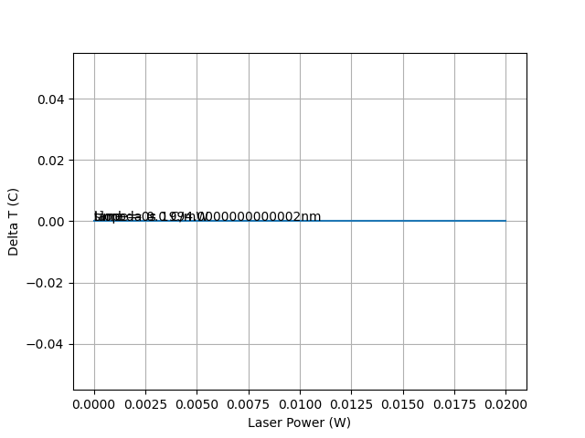
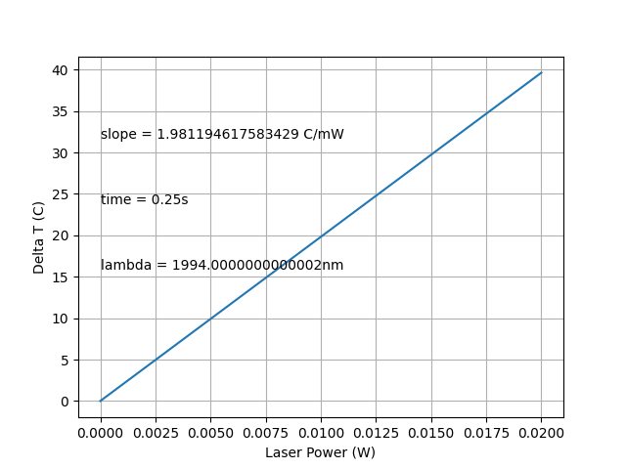
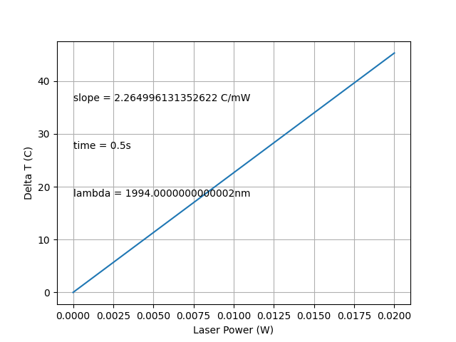
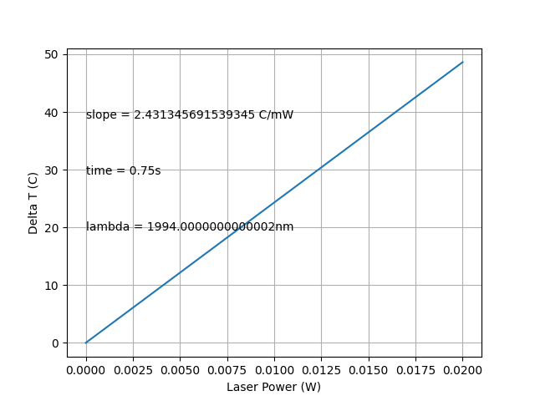
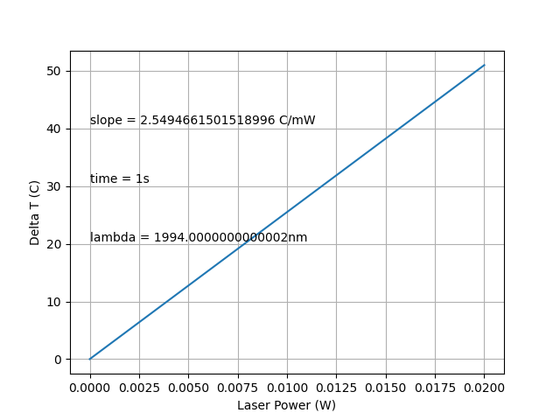
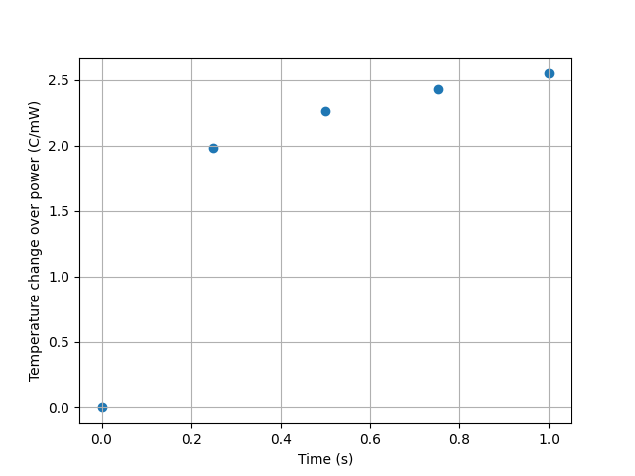
Varying Time
A
B
C
D
E
F
**The x-axis represents the initial power**

Slide 21
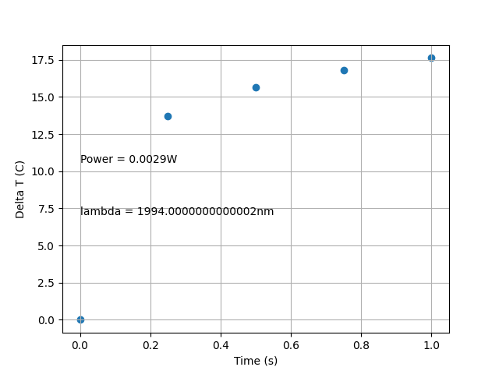
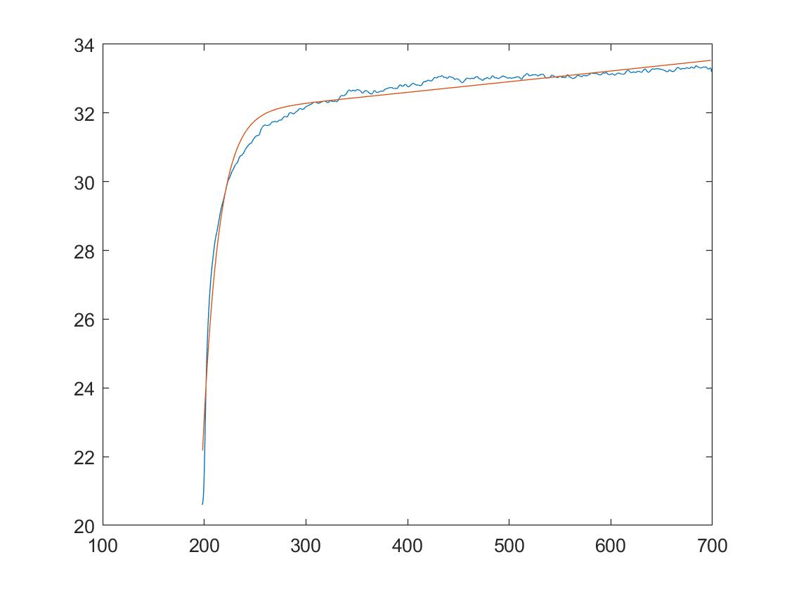
Comparison to Temperature Data

Slide 22
Next Steps
Looking for Neuron-based files in the codebase yielded only one result
Move through the rest of the repository (Jupyter Notebook / CSV files) in order to see the origin for the other graphs
Implement Varying Radius (accounting for elliptical shape)

